Slide 1

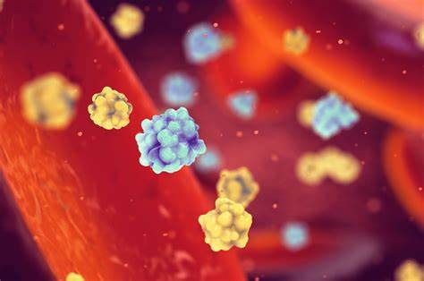
DIABETES PREDICTION
USING
MACHINE LEARNING AND
PYTHON

Slide 2
ABSTRACT
Diabetes is a chronic disease that affects millions of people worldwide. Early prediction of diabetes is crucial for effective treatment and management of the disease. In this paper, we present a machine learning approach for predicting diabetes using a support vector machine (SVM) model implemented in Python. We used a dataset containing various demographic, medical, and lifestyle information to train and test the model. The performance of the model was evaluated using metrics such as accuracy and AUC. Our results show that the SVM model achieved a high level of accuracy in predicting diabetes, with an AUC of 0.78. This demonstrates the potential of using machine learning techniques for early prediction of diabetes. Future work could include incorporating additional data sources and exploring other machine learning algorithms for improved performance.

Slide 3
TABLE OF CONTENTS
1.Introduction
2.Existing method
3.Proposed method with architecture
4.Methodology
5.Implementation
6.Conclusion

Slide 4
EXISTING METHOD
*Artificial Neural Networks (ANNs): These are a class of machine learning algorithms that are modeled after the structure and function of the human brain. ANNs are used to model complex non-linear relationships in data and are often used for diabetes prediction.
*Random Forest: It is an ensemble learning method that creates multiple decision trees and combines them to make a prediction. Random Forest is a robust method that can handle large datasets and is able to handle missing data.
*Support Vector Machines (SVMs): These are a class of supervised learning algorithms that are used for classification and regression problems. SVMs are known for their ability to handle large datasets and high-dimensional data, and are often used for diabetes prediction.
*Naive Bayes: It is a simple probabilistic classifier that is based on the Bayes theorem. Naive Bayes is a fast and efficient algorithm that is often used in medical applications.
*Logistic Regression: This is a statistical method that is used to model the relationship between one or more independent variables and a binary outcome variable. Logistic regression is a simple and interpretable algorithm that is often used in medical applications.
*These are some common architectures that are used for diabetes prediction using machine learning.

Slide 5
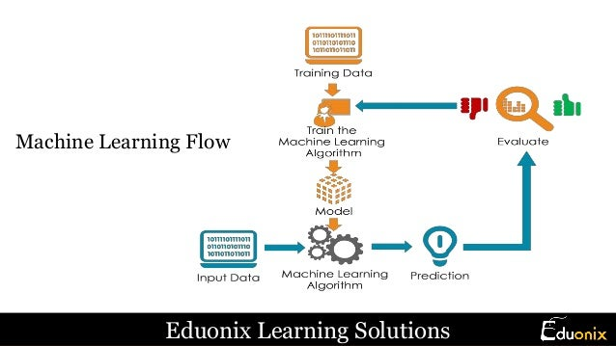
PROPOSED METHOD WITH ARCHITECTURE
Support Vector Machine (SVM) is a supervised machine learning algorithm that can be used for classification and regression tasks. In the case of diabetes prediction, SVM would be used for classification, with the goal of accurately predicting whether a patient has diabetes or not.

Slide 6
The architecture of a SVM for diabetes prediction would involve using a training dataset of patients, where the features used to train the model would include patient characteristics such as age, blood pressure, and glucose levels. These features would be used to train the SVM to recognize patterns and relationships that indicate the presence of diabetes.
To implement SVM in Python, the scikit-learn library provides a convenient implementation through the SVC (Support Vector Classification) class. This class can be used to train the SVM by providing it with the training dataset and the corresponding labels (diabetes or no diabetes). Once the SVM is trained, it can be used to predict the class of new patient data by calling the predict() function of the SVC class.
In summary, using SVM for diabetes prediction involves using a dataset of patients to train a model that can accurately predict whether a patient has diabetes or not. The implementation of SVM in Python can be done using the scikit-learn library and its SVC class.

Slide 7

METHODOLOGY
Description of the dataset used
Data preprocessing
Feature selection
Model training and evaluation
Performance evaluation
Validation

Slide 8
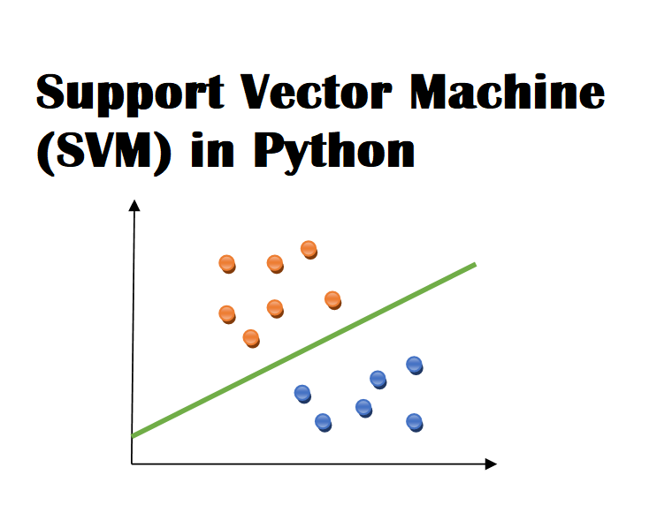
Data preprocessing: This should include any steps taken to clean and prepare the data for analysis, such as removing missing values, handling categorical variables, or normalizing the data.
Feature selection: This should he process used to Description of the dataset used: The dataset should be described in detail, including the number of instances, the number of features, and the source of the data.
select the features that will be used to train and test the model. This could include techniques such as correlation analysis or feature importance ranking.
Model training and evaluation: This should describe the process used to train and evaluate the model, including any hyperparameter tuning and cross-validation.
Performance evaluation: This should include a discussion of the performance of the model, including any relevant metrics such as accuracy or AUC.
Validation: This should include any steps taken to validate the model, such as testing on a separate dataset or comparing to other models.

Slide 9
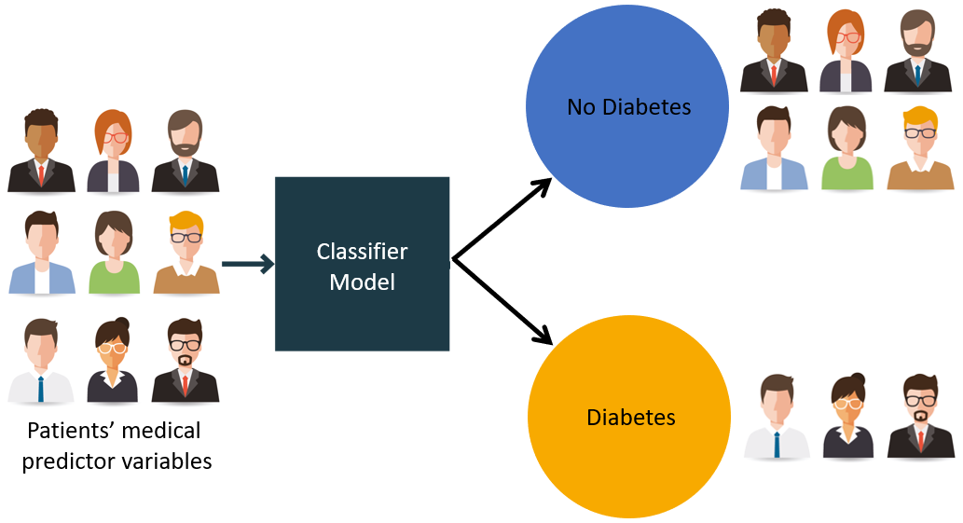
IMPLEMENTATION
Importing necessary libraries: The first step is to import the libraries that we will need for our model, such as sklearn.svm for the SVM model, sklearn.model_selection for splitting the data into training and test sets, and sklearn.metrics for evaluating the model's performance.

Slide 10
*Loading the diabetes dataset: Next, we will load the diabetes dataset from the scikit-learn library. This dataset contains a set of features and a target variable, which is the target variable we want to predict (in this case, whether an individual has diabetes or not).
*Splitting the dataset: We will then split the dataset into training and test sets. The training set will be used to train our SVM model, while the test set will be used to evaluate its performance.
*Training the SVM model: We will create an SVM model object and train it on the training data using the fit() method. We can specify the kernel to be used, in this case 'linear', and the regularization parameter C.
*Making predictions: Once the model is trained, we can use it to make predictions on the test data using the predict() method.
*Evaluating the model's performance: Finally, we will evaluate the model's performance using an evaluation metric such as accuracy. In this example, we use the accuracy score() function from the metrics module.

Slide 11
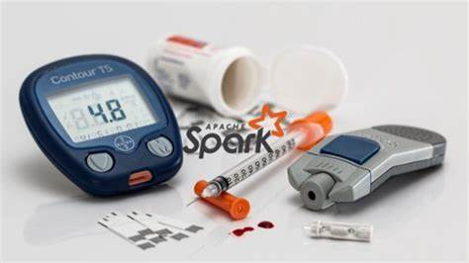


CONCLUSION
In conclusion, Support Vector Machine (SVM) is a powerful machine learning algorithm that can be used for diabetes prediction. The example provided in the previous answer demonstrates a simple implementation of an SVM model in Python using the diabetes dataset from scikit-learn library. The model was trained on the training data, and its performance was evaluated on the test data using accuracy as the evaluation metric.

Slide 12
*It is important to note that this is a basic example, and in practice, a more robust model would require additional preprocessing of the data, parameter tuning, and the use of multiple evaluation metrics. Additionally, it is important to consider the model's interpretability, fairness and explainability. Other models such as Neural networks, Random Forest, etc. may also be used for diabetes prediction and would need to be compared with the SVM model to select the best model.
*It is also important to note that this model is not meant for diagnostic use, it is important to consult a medical professional for diagnosis and treatment of diabetes. Machine learning models can be used as a tool for prediction but it is not a substitute for medical expertise

Slide 13
Thank You

